Slide 1

USA COVID-19 Hospitalization ETL Pipeline
Group 7: Shikha Dayma, Grace Jo, Suhel Karara, Sung Pil Kim, Vidhish Vedala

Slide 2
TABLE OF CONTENTS
01
BACKGROUND
04
COST IMPLICATION
02
DATA SOURCE
05
EVALUATION METRICS
03
IMPLEMENTATION DESIGN
06
CONCLUSION
Define the data analytics problem
Breakdown by technologies used
Specification & Procurement Details
Assessment of Success
Rationale of choice
Future Recommendations

Slide 3
HOSPITALIZATION DATA TRANSPARENCY ISSUES
Availability of ICU beds not updated for over a week
“The new faster and complete data system is what our nation needs to defeat the coronavirus” – Michael Caputo
Data now available to the public is not faster nor more complete
CASE I
CASE II
3,205 COVID-19 patients in Arizona were reported to occupy 24% of the state’s inpatient hospital beds
State dashboard listed 341 patients hospitalized in Colorado with confirmed or suspected COVID-19 cases
Turns out 82 fewer COVID-19 patients were hospitalized, but bed occupancy rate had jumped to 42%
Later that month, the updated patient number was 491
Notes:
According to the dataset posted on July 30, 92% of hospitals have reported some information to HHS in the past week, ranging from 75% in Delaware to 100% in eight states, including Nevada, Iowa, and Minnesota.

Slide 4
DATA DESCRIPTION & SOURCE
Dataset
Source & Procurement
COVID-19 Reported Patient Impact & Hospital Capacity by State
State aggregated data from 1/1/2020 (in time series format) with 22k rows and 61 columns.
Data gets updated daily
Various measures of COVID-19 burden: hospital occupancy & availability
Eliminated duplicate data
Disregarded “no response” as missing data
Data Source: Healthdata.gov.in
Derived From:
HHS TeleTracking
Reporting provided by state health departments to HHS Protect
National Healthcare Safety Network

Slide 5
IMPLEMENTATION DESIGN
Front-end Web Application
MongoDB
Apache Spark
Provides a layout where the user can execute a call for specific data requirements.
Records input to retrieve data from the backend noSQL repository
Real-time Data Storage
Facilitate 3 Vs: volume, variety, and velocity
Searched Data will be indexed, extracted, transformed then loaded into Apache Spark
Facilitate data operations for data analysis & ML applications
Data loaded as JSON format then converted into spark df

Slide 6
RATIONALE
Front-end User Search Interface | Mongo-DB | Apache Spark
Allows horizontal scaling
Can handle data with heterogeneous fields (schema-less or schema optional)
Eliminates expensive joins for data query
Sharding and replication makes it faster to index large volumes of data.
Quick processing, manipulation, and flexible analysis of large data
Allows usage of various languages
Can integrate various databases
Immutable & can avoid inconsistencies
Allow Users to search information by state or date
User input will be used as a search criterion to pull out data from mongodb
Global usage
Notes:
This is the first aspect of the pipeline, where the user gets
to search information by state or date. The user input will be used as a search criterion to
pull out data from mongodb, where our data is stored. (check assignmemt 1 or flask
application. Mention the technology being used here)

Slide 7
Limitations
Front-end User Search Interface | Mongo-DB | Apache Spark
As per CAP theorem, availability aspect is compromised in order to accommodate for consistency and partitioning
Limited support of ACID transactions
Different shards have to be stored on different nodes/servers, which implies that a routing service is needed to route a write or read request to the appropriate shard.
No Real Time Processing of Data/RDD
Does not process large amounts of small files well
High Latency of data processing compared to other tools
Spark let’s data build in memory before processing it. This is not helpful when resources are limited and can cause data loss
Designing an efficient UI could be challenging
Incorrect searches could lead to inaccurate data retrieval or errors

Slide 8
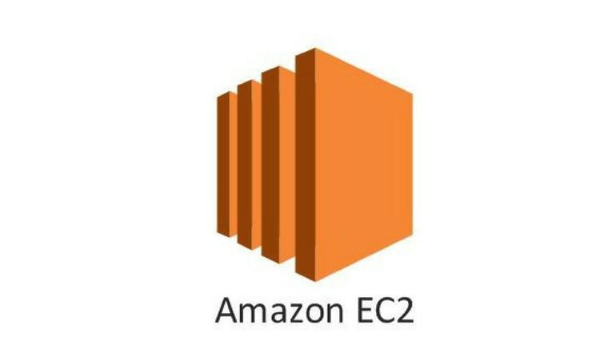


COST IMPLICATIONS
Database
BUDGET: $5000-$10000
Web Application
Read & Write Requests
$1.25/million write request
$0.25/million read request
Data Storage
First 25 GB/month = free
$0.25/GB-month thereafter
x1.16xlarge (Memory Optimized)
1hr = $3.67/hr
c6g.medium (Compute Optimized)
1hr = $0.019/hr
Open source and free of cost
Cheap to operate and manage
MongoDB: Horizontal scaling of big data implies that a routing service is needed to route a write or read request to the appropriate shard.
UI: Third party services may be needed to build a high quality UI

Slide 9
EVALUATION METRICS
DATA CONTENT
QUALITATIVE
QUANTITATIVE
PROCESSING TIME
Completeness of hos application system data
Difference btw the start/end time of an ETL process
DATA QUALITY
QUERY ACCURACY
Validity of data values
With regards to expectations
USER SATISFACTION
DATA WAREHOUSE COST
In utilizing the system
Both on initial installation & ongoing expense
RULES/POLICIES
AVAILABILITY
Applicable rules that govern the system
% of time the system can be access by the users
SYSTEM PERFORMANCE
Low processing time and high accuracy achieved
Costs are minimized
Architecture is curated taking into account data anomalies (robust architecture)

Slide 10
RECOMMENDATIONS
Cost Reduction
System Improvement
Real-Time Data
Provide
Visualization
Enable Scaling up
by designing the ETL pipeline as efficiently as possible
by taking into account the limitations of mongodb and apache spark
by automating updation of real-time Covid data
by creating a pipeline that gives insights to the user based on search
by making the ETL pipeline flexible to accommodate scaling up

Slide 11
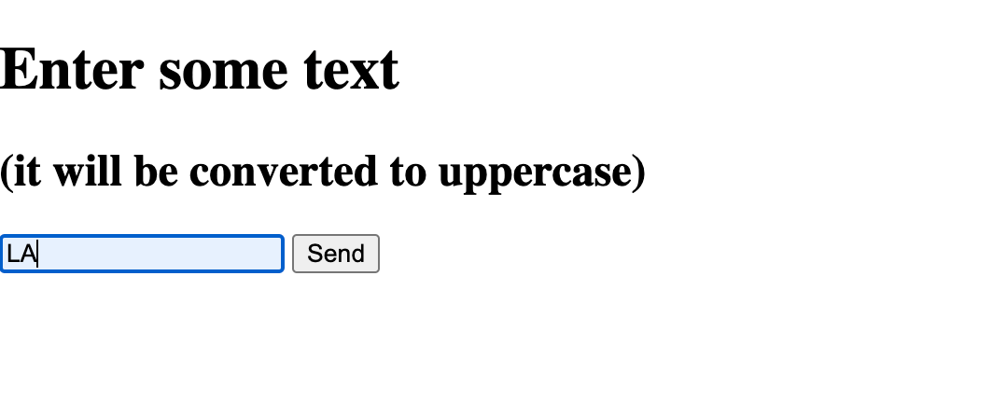
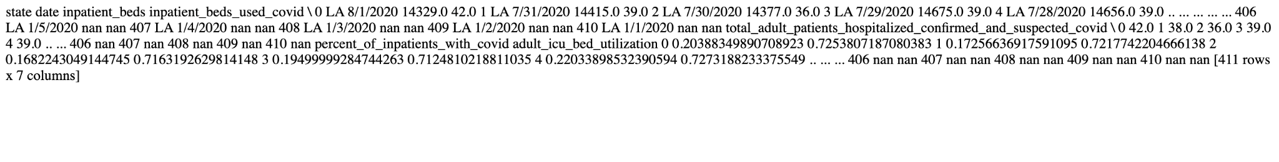
CODE IMPLEMENTATION
User Input
Pandas df run time
Duration: 0:00:00.189112
Spark df run time:
Duration: 0:00:00.171173
ETL Pipeline Output
Run time for spark interactive application was better than pandas. The difference is not significant in this case because our data is relatively smaller.
Upon running complex aggregations or ML functions, run time difference would be very evident.

Slide 12
Thank You!

